Slide 1

Type 2 Diabetes Mellitus Prediction
Muhammad Faisal Shahid

Slide 2
Overview
Overview of Data
Models Evaluation for T2DM
Pancreatic Cancer Model
Future Directions

Slide 3
Domain Study
Literature review of published Paper
Diabetes – the Essential facts (Coursera)
Relevant Articles

Slide 4
Our Data
EHR data (2011-2021)
 | Total | Shortlisted (if any) | Reason
Encounters | 5,092,987
Patients* | 1,145,465
Diagnosis Code | 29,714
Practices | 738 | 295 | Based on T2DM Diabetics
Vitals | 18 | 9 | Based on Missing Value Ratio (MVR)
Demographics | 8+ | 3
*Patients distribution on next slide

Slide 5
Patients Distribution
Total Patients
1,145,465
T2DM Patients
72,626
Other Patients
1,072,839
Patients with at least 3 Encounters
4,896
Other Patients
67,730
Patients with at least 3 Encounters
31,338*

Slide 6

Preprocessing
Missing data (in vitals)
Threshold >60% (filled with EWMA method)
Class Imbalance
Equal number of Positive and Negative examples
*Under sampling Criteria is planned to change in Future Work

Slide 7
Dataset Features
Category | No. of features
Diagnosis Code | 769
Vitals | 6
Demographics | 3
Total | 778
Total features with demographics encoding = 788

Slide 8
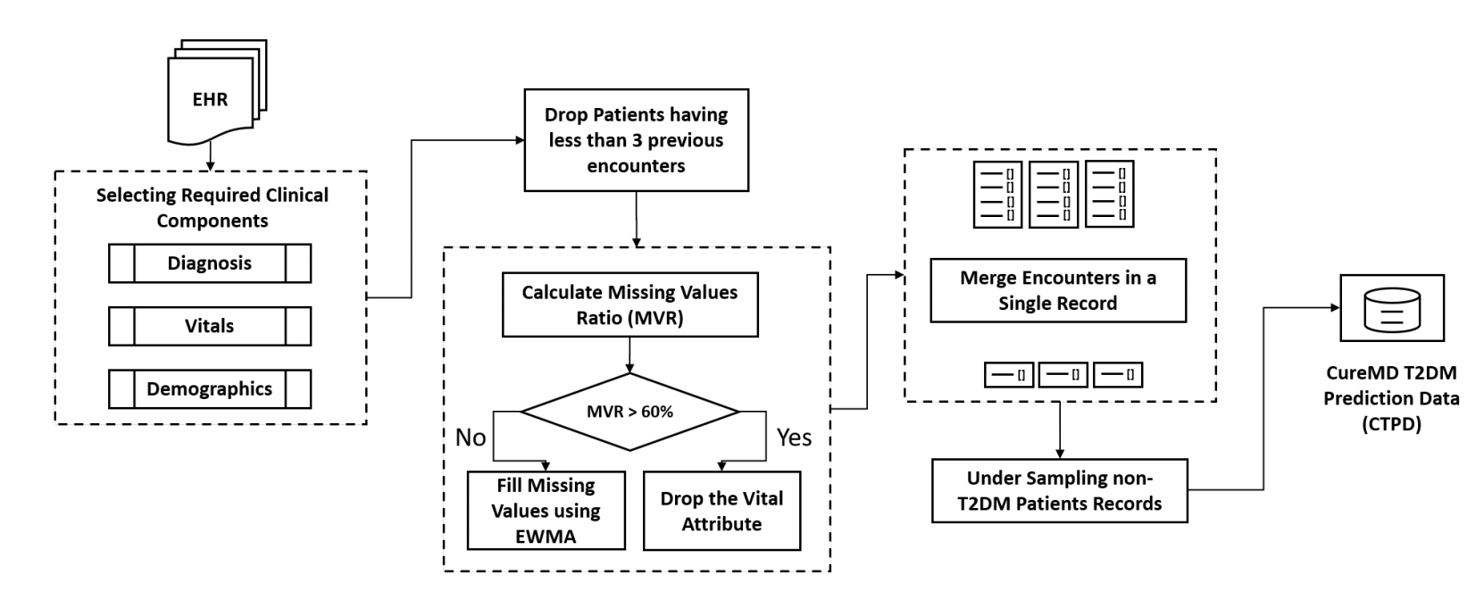
Preprocessing Pipeline

Slide 9
Classifiers Results
Algorithm | Accuracy | Precision | Recall | F1 score | AUC
Logistic Regression | 0.876 | 0.881 | 0.868 | 0.875 | 0.876
Random Forest | 0.815 | 0.795 | 0.849 | 0.821 | 0.815
Naïve Bayes (G) | 0.707 | 0.652 | 0.888 | 0.752 | 0.707
KNN | 0.722 | 0.648 | 0.973 | 0.778 | 0.722
SVM (Linear) | 0.876 | 0.878 | 0.873 | 0.875 | 0.876
SVM (Sigmoid) | 0.851 | 0.854 | 0.848 | 0.851 | 0.851
Bagging Classifier | 0.811 | 0.805 | 0.821 | 0.813 | 0.811
AdaBoost (RF) | 0.835 | 0.805 | 0.884 | 0.843 | 0.835
Naïve Bayes (B) | 0.812 | 0.76 | 0.914 | 0.83 | 0.812
Naïve Bayes (M) | 0.806 | 0.75 | 0.919 | 0.826 | 0.806
Decision Tree | 0.774 | 0.779 | 0.771 | 0.773 | 0.774
XGBoost | 0.782 | 0.788 | 0.772 | 0.78 | 0.782

Slide 10
Diabetes Prediction for Patients with Pancreatic Cancer
Pancreatic Cancer Leading to Diabetes

Slide 11
Preprocessing
One-hot encoding
Age calculation
Patients Vitals
Patients Splits
Scaling

Slide 12
Pancreatic Cancer Patients Distribution
Total Patients
2,432
Diabetic Patients
229
Other Patients
2,203
Diabetes (first diagnosed)
69
Pancreatic Cancer (first Diagnosed)
84
Simultaneously diagnosed*
76
Under sampled
250
*Assumed that Diabetes diagnosed first
*Results yet to be evaluated

Slide 13
Dataset
First Diagnosis | Second diagnosis | No. of Patients
Pancreatic Cancer | Diabetes | 84
Diabetes | Pancreatic Cancer | 69
Both Diagnosed Simultaneously = 76
For Pancreatic Leading to Diabetes Model
Patients with Pancreatic Cancer led to Diabetes = 84
Patients with Pancreatic Cancer but non Diabetic = 250 (Sampled from 2203 patients)
With 297 features

Slide 14
Classifiers Results
Algorithm | Accuracy | Precision | Recall | F1 score | AUC
Logistic Regression | 0.811 | 0.774 | 0.46 | 0.564 | 0.699
SVM (Linear) | 0.803 | 0.846 | 0.349 | 0.481 | 0.657
Random Forest | 0.773 | 0.681 | 0.254 | 0.35 | 0.607
AdaBoost (RF) | 0.782 | 0.952 | 0.19 | 0.309 | 0.592
Decision Tree | 0.794 | 0.694 | 0.508 | 0.571 | 0.703
XGBoost | 0.752 | 0.56 | 0.429 | 0.474 | 0.649

Slide 15
Important Features by Shap
Feature Rank | Feature | %Contribution
11 | Disorders of thyroid gland | 1.61
12 | weight | 1.45
13 | Nausea and vomiting | 1.43
14 | height | 1.4
15 | pulse | 1.38
16 | Diseases of the circulatory system | 1.37
17 | bp_mean | 1.2
18 | Hypotension | 1.14
19 | Other diseases of urinary system | 1.09
20 | Volume depletion | 0.96

Slide 16
Important Features by Permutation Importance
Feature Rank | Feature | %Contribution
11 | Cachexia | 2.55
12 | Nausea and vomiting | 2.51
13 | venous embolism and thrombosis | 2.48
14 | Age | 2.43
15 | Abnormal tumor markers | 2.30
16 | Urinary tract infection | 2.27
17 | Volume depletion | 2.25
18 | Osteoporosis without pathological fracture | 1.98
19 | Poisoning by drugs, medicaments and biological substances | 1.78
20 | Other forms of heart disease | 1.75

Slide 17
Top Risk Factors

Slide 18
Pancreatic Cancer Prediction for Patients with Diabetes
Diabetes leading to Pancreatic Cancer
Work in progress…

Slide 19
Future Directions (June 2023)
Add Class Imbalance in T2DM model
Feature Selection
Rules Generation for ensemble methods
Explainability of results

Slide 20
Thank you!

